Slide 1
SIGN LANGUAGE TRANSLATOR
Presented By :
Akhil A (UKP16CS006)
Akhin A (UKP16CS007)
Ashik SB (UKP16CS014)
Harigovind K (UKP16CS024)
Guided By :
Ms. Remya Shaji
Assistant Professor
CSE

Slide 2
CONTENTS
Introduction
Problem Description
Existing System
Proposed System
Modules Description
Data Flow Diagram
Requirements
Sample Output Screenshots
Future enhancement
Conclusion
References

Slide 3
INTRODUCTION
Gestures are the most common body language, which can be used for human computer interaction.
Gesture recognition is a challenge while using gesture as a communication medium.
We need to extract features and perform recognition based on those features.
Mostly neural networks are used for this purpose.

Slide 4
PROBLEM DESCRIPTION
“How the problems faced by mute people can be accommodated with technological assistance and the barrier of expressing emotions can be overshadowed.”

Slide 5
EXISTING SYSTEM
Gesture detection :
~ Contact devices :- Data gloves
~ Non contact devices :- Information entropy algorithm
Kinect’ Sensor by Microsoft

Slide 6
PROPOSED SYSTEM
Application that can recognize American Sign Language using a Convolutional Neural Network
Features :
Real time (ASL) detection based on gesture made by user.
Customized gesture generation.
Sentence formations and TTS assistance

Slide 7
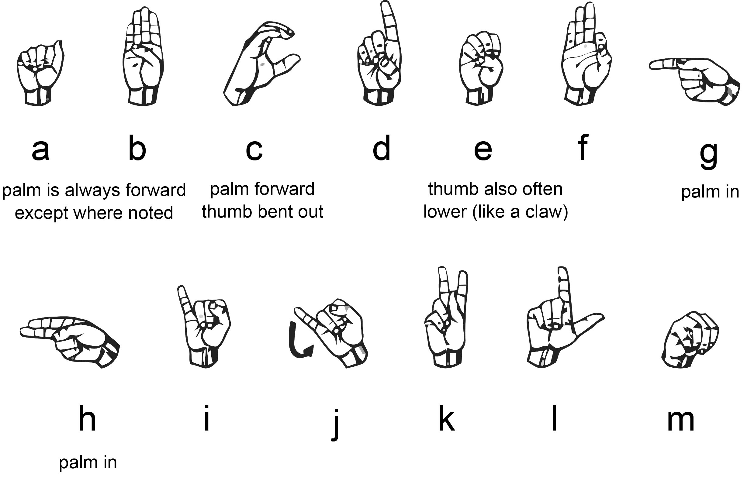
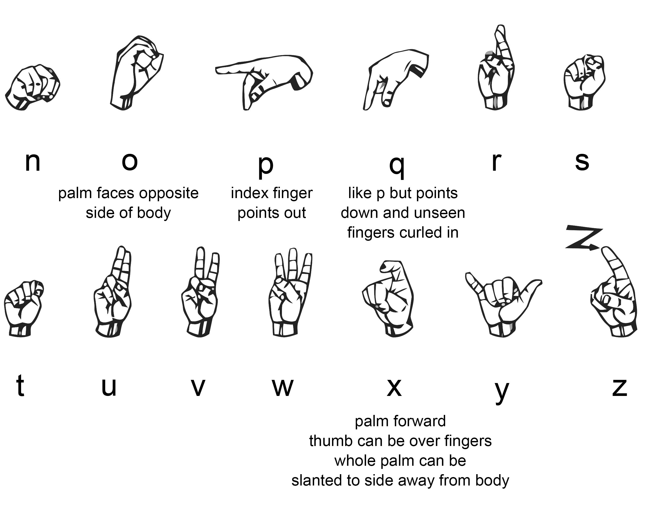

Slide 8
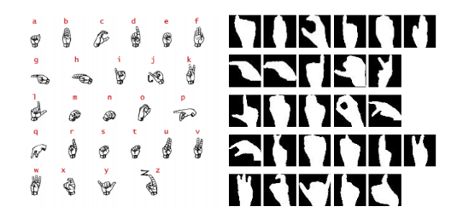

Slide 9
MODULES DESCRIPTION
Core Modules :
Scanner
Data Pre-Processing
Gesture Processing
Custom Gestures
Predicted Output

Slide 10
Scanner
The module that uses the webcam to capture images
OpenCV is used for capturing the images
Data Pre-Processing
Here we are converting the image to HSV format
HSV is alternative representation of RGB
This HSV values are adjusted to get sharper image
OpenCV package is used

Slide 11
Gesture Processing
• This module act as the classifier .
• We are using a CNN with 3 convolution layers.
• Dataset : ASL alphabet by Kaggle
• Training Data : 45500 (1750x26)
• Test Data : 6500 (26x250)
• The Evaluation Results 90% of accuracy with 9% loss.
• This module returns an alphabet corresponding to the sign.

Slide 12
Custom Gestures
• User can define gesture with custom meaning like words, emotions etc.
• Initially image is captured and its HSV mask is generated
• HSV file is saved as a .png file
• The file is saved in a directory named with the word that means
Predicted Output
• Gestures are recognized and corresponding meaning can be displayed
• These outputs can be combined to form sentences

Slide 13
DATA FLOW DIAGRAM
Scanner
Pre-processing
Gesture Processing
Custom Gesture Scan
Output prediction

Slide 14
Data Pre Processing
Scanner
Create Gestures
Scan Gestures
Sequence of Gestures
Compare
With
Stored
Pixel
Value
Stored Gestures
With Label
Generate Label
Single Gestures
Scanner
Stop When Delimiter
Encountered
Define
Associated
Label
Generate
with Label
Export to file
Export to file
Show
Generated
Labels

Slide 15
REQUIREMENTS
Minimum Hardware Requirements
Intel Pentium Dual Core E6600 2.6Ghz / AMD Athlon II X2260
512 MB Disk Space
2GB RAM
256 MB VRAM
USB Keyboard, Mouse & Speaker
2MP VGA webcam & Monitor

Slide 16





Software Requirements
OS : Window 7 or later, Linux or macOS
Python 3.6.
TensorFlow framework, Keras API
Real-time computer vision using OpenCV
Industrial standard GUI application (PyQT5), Tkinter.
Offline TTS assistance for python

Slide 17
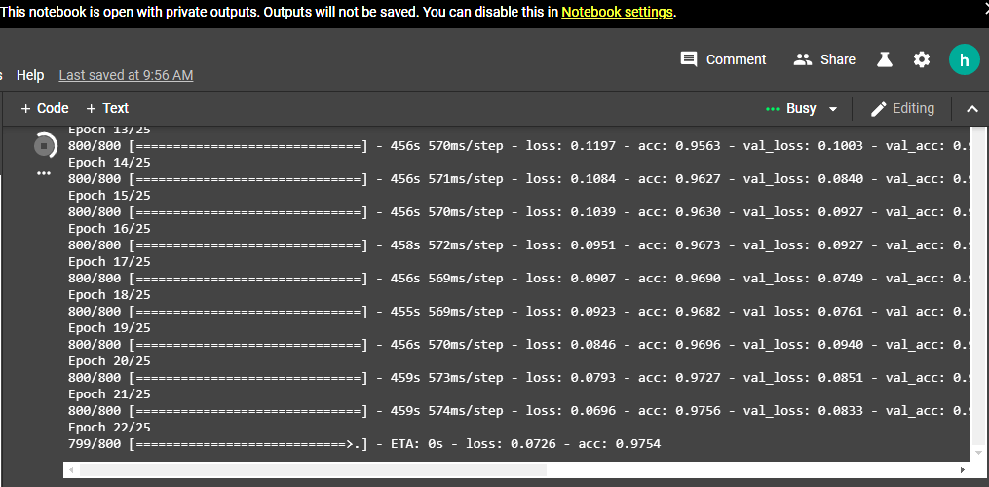
SAMPLE OUTPUT SCREENSHOTS
Fig 1 : Model Training

Slide 18
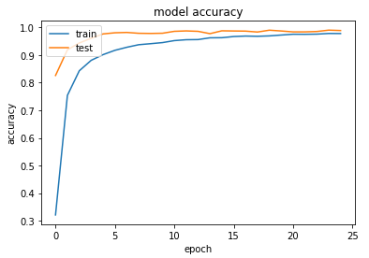
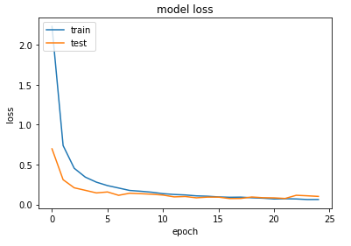
Fig 2 : Model Evaluation

Slide 19
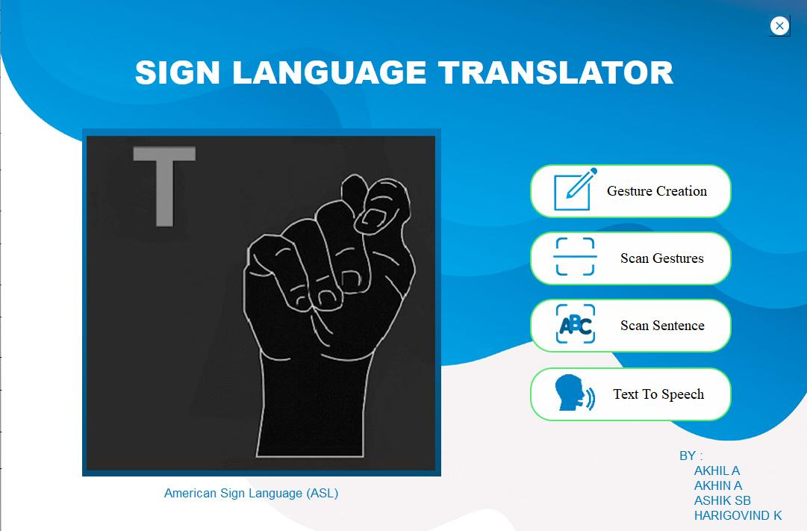
Fig 3 : Main UI

Slide 20
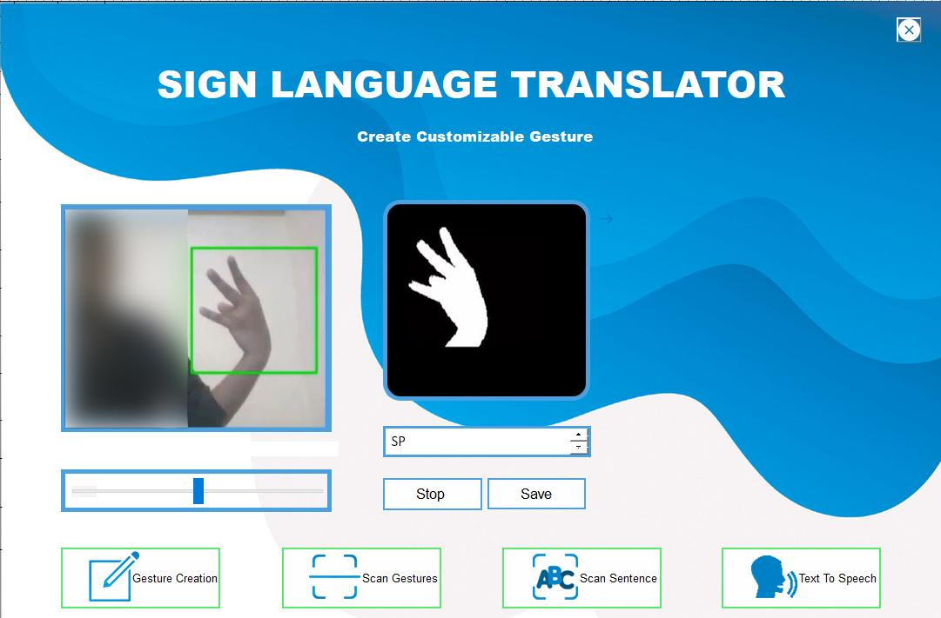
Fig 4 : Create Customizable Gesture

Slide 21
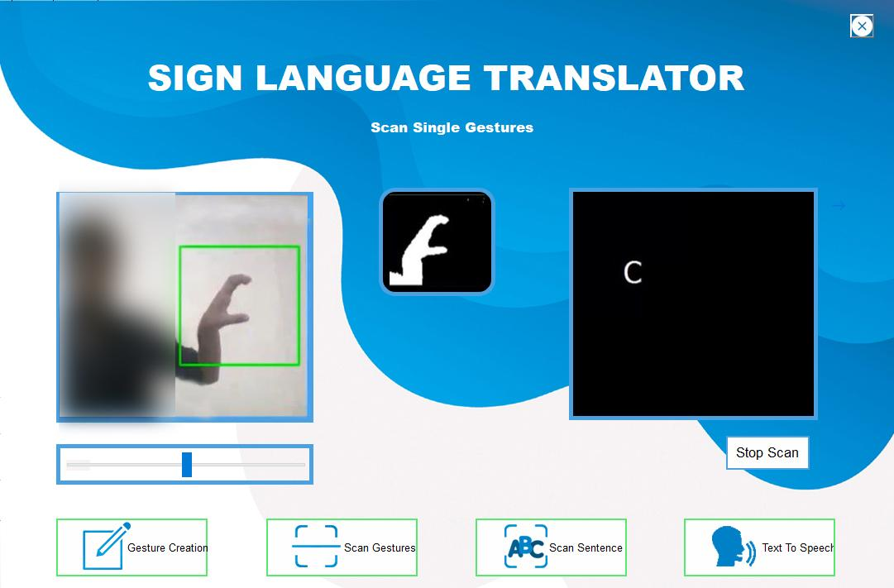
Fig 5 : Scan Single Gesture

Slide 22
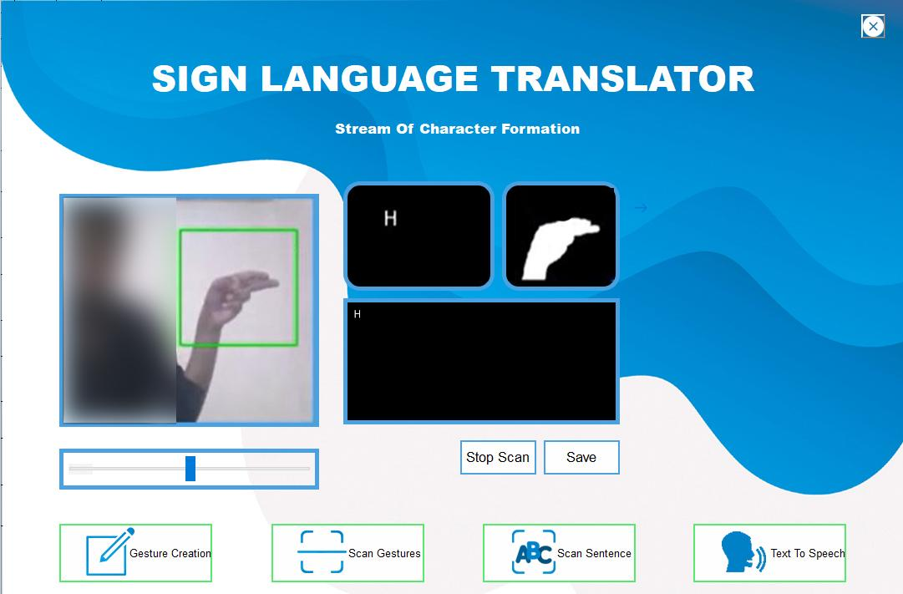
Fig 6 : Stream Of Character Formation

Slide 23
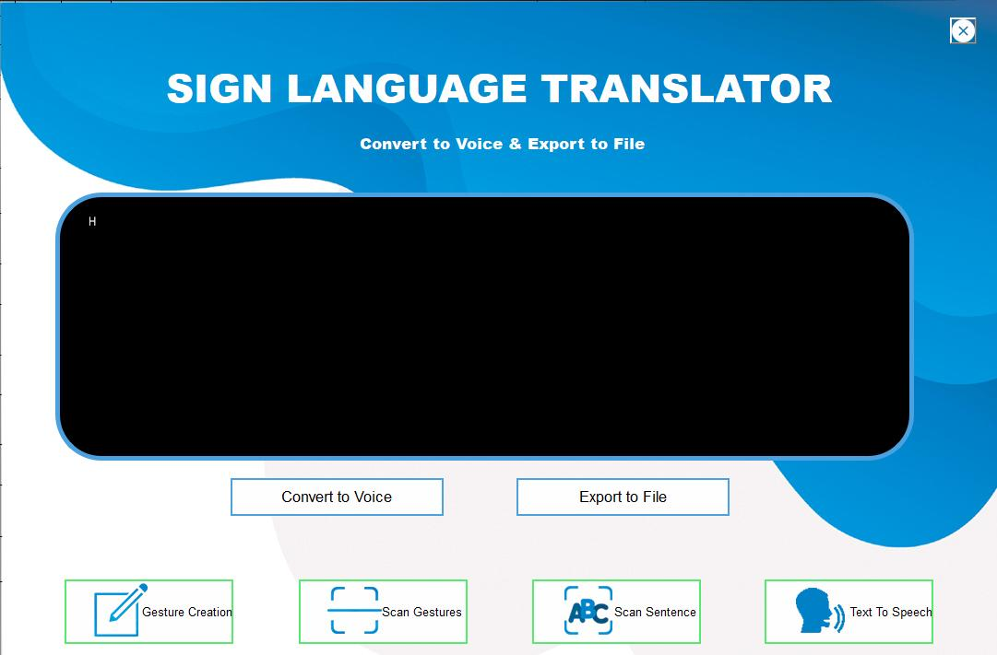
Fig 7 : Convert to Voice & Export to File

Slide 24
FUTURE ENHANCEMENT
Image pre-processing can be improved using advance algorithms
Contrast slider can be automated
Software can be embedded in wearables
Software can be modified for playing games and chatting

Slide 25
CONCLUSION
A method of gesture recognition based on CNN is introduced and evaluation of the model in a real-world environment.The experimental results show that our model can achieve good results.The network also supports the addition of more gestures. In the future, we can even use gestures to play games, chat and email with others. Although the accuracy obtained by the experiment has been very high, we feel that it is necessary to further improve for the application to real life

Slide 26
REFERENCES
[1] Shobhit Agarwal, “What are some problems faced by deaf and dumb people while using todays common tech like phones and PCs”, 2017 [Online].
[2] NIDCD, “American sign language”, 2017 [Online]. Available: https://www.nidcd.nih.gov/health/american-sign-language, [Accessed April 06, 2019].
[3] NAD, “American sign language-community and culture frequently asked questions”, 2017 [Online].
[4] J. Lee, Y. Lee, E. Lee, and S. Hong, ``Hand region extraction and gesture recognition from video stream with complex background through entropy analysis,'' in Proc. Conf. IEEE Eng. Med. Biol. Soc., Jan. 2004, vol. 2, no. 2, pp. 1513_1516.

Slide 27
[5] Wei Fang1,2, Yewen Ding 1, Feihong Zhang1, And Jack Sheng3, ``Gesture Recognition Based on CNN and DCGAN for Calculation and Text Output'', February 27, 2019,
[6] T. Takahashi and F. Kishino, ``Hand gesture coding based on experiments using a hand gesture interface device,'' ACM Sigchi Bull., vol. 23, no. 2, 1991.
[7]Wikipedia, “Convolutional neural network”, 2017 [Online]. Available: https://en.wikipedia.org/wiki/Convolutional_neural_network, [Accessed April 08, 2019].
[8] Ricky Anderson ,FannyWiryana ,Meita Chandra Ariesta, ``Sign Language Recognition Application Systems for Deaf-Mute People: A Review Based on Input-Process-Output,''2017 [Online].

